Slide 1
Step Into Java:
Classes, Objects,...
Review
Mr. Neat
Java

Slide 2
Let’s play with some new
classes:
Ramblecs.java
LetterPanel.java
FallingCube.java

Slide 3
Copy these files plus
TestRamblecs.html from
the disk. Put in a new dir.
Compile and run these files

Slide 4
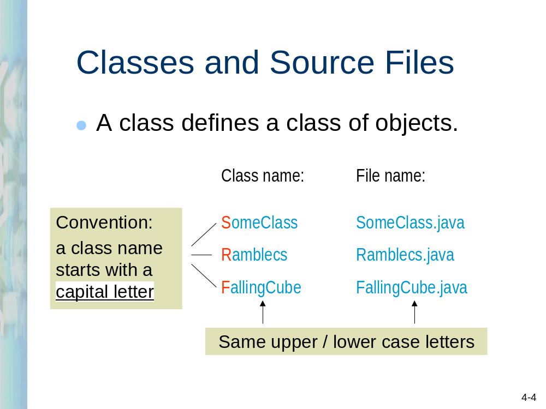

Slide 5
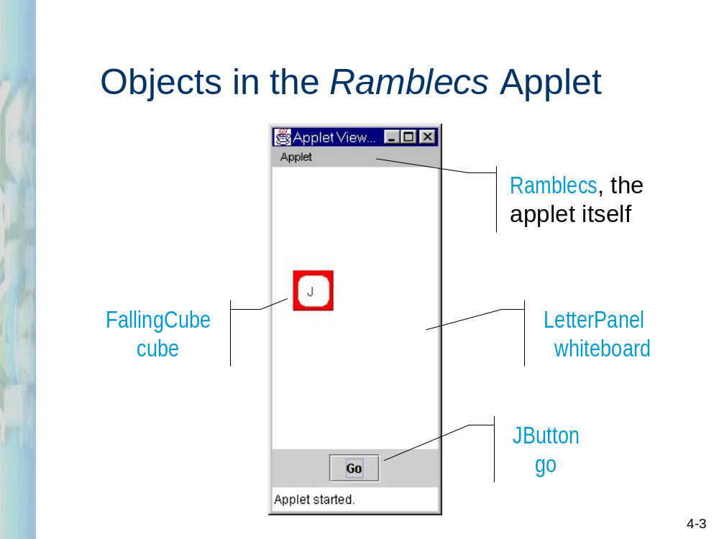

Slide 6
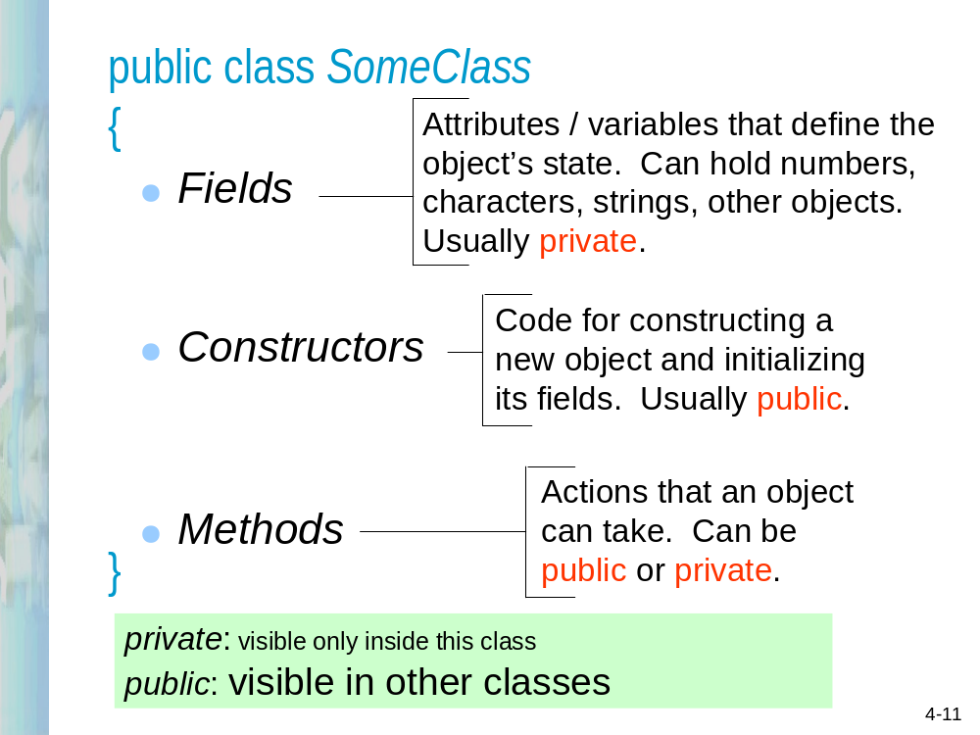

Slide 7
import java.awt.*;
public class FallingCube
{
private final int xLeft; // Left margin for cubes
private final int cubeSize;
private int cubeX, cubeY; // Cube coordinates (upper left corner)
private int yStep; // Distance (in pixels) to move down
// in one timer cycle
private static final String letters = "ABCDEFGHIJKLMNOPQRSTUVWXYZ";
private char randomLetter; // Cube letter
public FallingCube(int size)
{
cubeSize = size;
xLeft = cubeSize / 2;
yStep = cubeSize / 8;
cubeX = -cubeSize; // off the board --
cubeY = -cubeSize; // not displayed
}

Slide 8
public void start()
{
int i = (int)(Math.random() * letters.length());
randomLetter = letters.charAt(i);
cubeX = 0;
cubeY = -cubeSize; // above the board for smooth entry
}
public boolean moveDown()
{
if (cubeY < 6 * cubeSize) // board's height is 7 * cubesize
{
cubeY += yStep;
return true;
}
else // land this cube:
{
return false;
}
}

Slide 9
Lab1
- change the background to yellow!
- change the label on the go button
to “push”.
- change the speed of the falling cube
- make the same letter come out
every time

Slide 10
Classes in the
Ramblecs
Applet
Ramblecs
(
applet
)
LetterPanel whiteboard
JButton go
FallingCube cube

Slide 11
Fields
You name it!
private
(or
public
)
[
static
]
[
final
]
datatype
name
;
Usually
private
May be present:
means the field
May be present:
is a constant
means the field is
shared by all objects
int
,
double
, etc., or an
in the class
object:
String
,
JButton
,
FallingCube
,
Timer

Slide 12
Static Field
“Ramland”
cube1
cube2
cube3
cube4
Xleft
yStep
cubeX
cubeY
7
26
19
54
22
41
60
7
1
7
21
12
0
11
7
18
letters
ABCDEFGHIJKLNMOPQRSTUVWXYZ

Slide 13
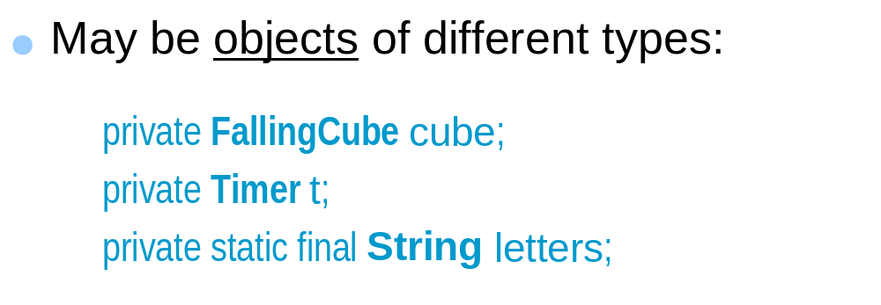
Fields (cont’d)
●
May have
primitive data types
:
int
,
char
,
double
, etc.
private
int
cubeX
,
cubeY
; // cube coordinates
...
private
char
randomLetter
; // cube letter
4-
15

Slide 14
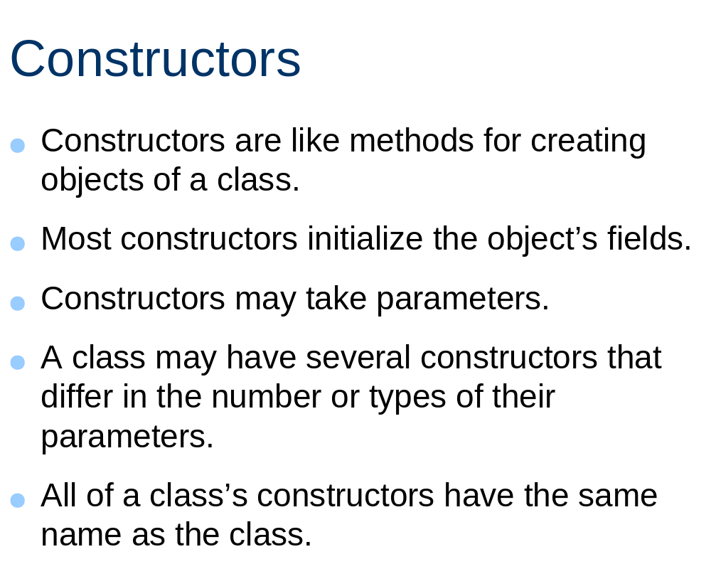

Slide 15
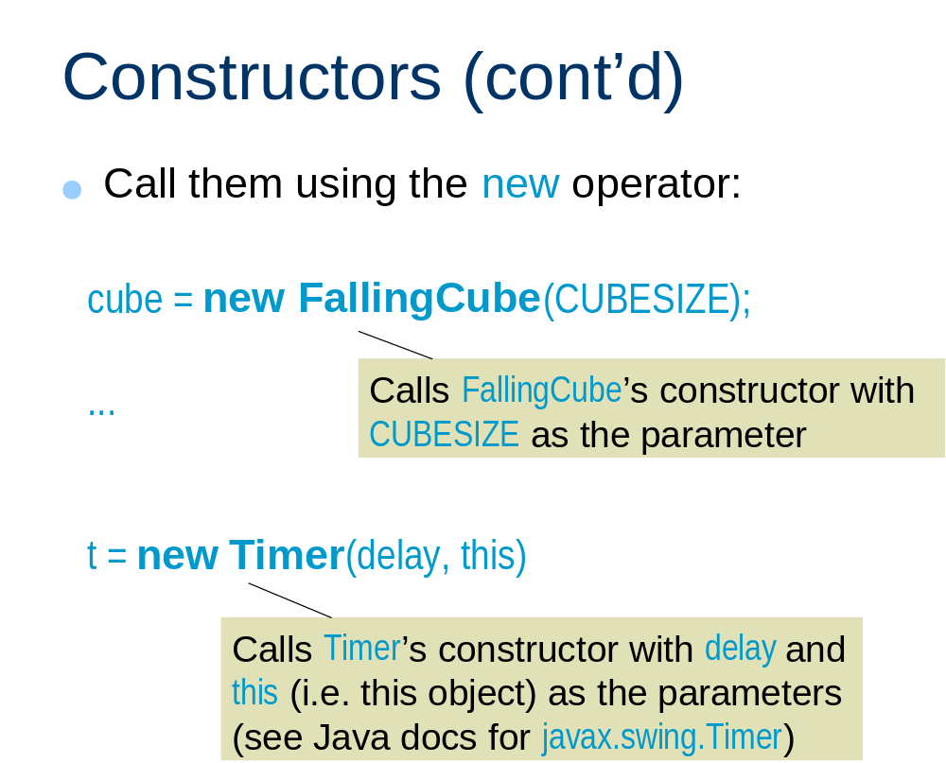

Slide 16
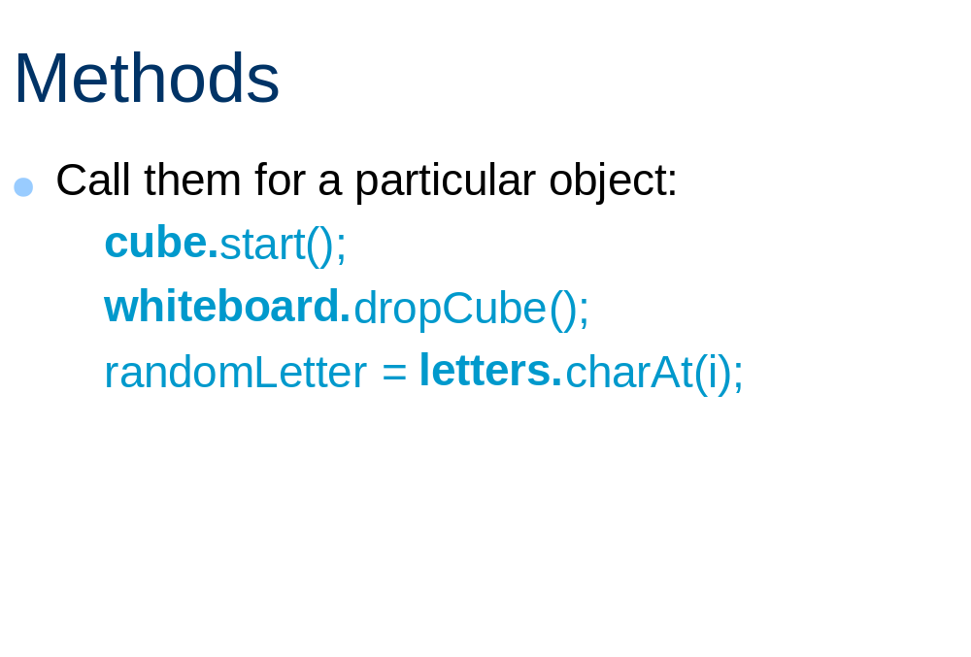

Slide 17
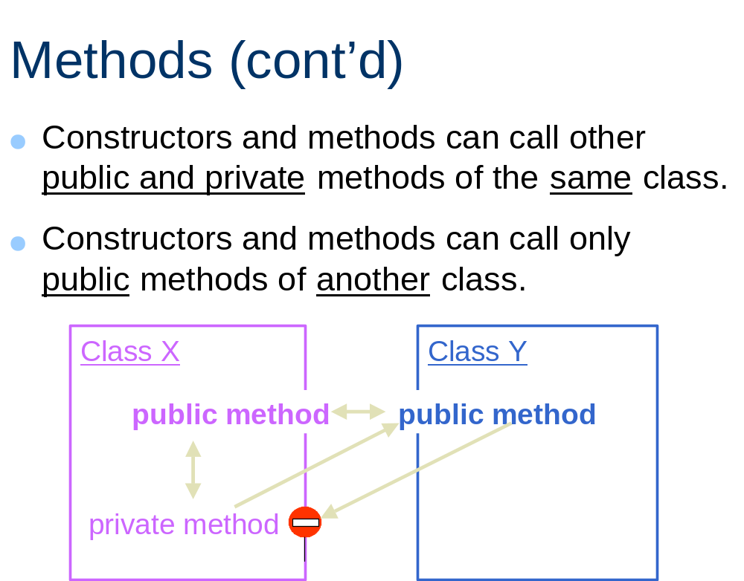

Slide 18
Lab 2
1) change the cube size to
a value larger, then smaller than
its present value. Where does
the cube stop with its new value?
2) Change the code so that the
cube stops at the bottom of the
whiteboard, independent of cube
size.

